Slide 1


NURTURING RESILIENCE
Tamara Brito SEMH Advisory Teacher
Dr Oonagh Davies Specialist Senior Educational Psychologist SEMH
Social, Emotional and Mental Health Specialism Teams
*With thanks to Professor Angie Hart and VIGuk for the use of some slides*

Slide 2
WHAT IS THE LINK?
Its influence on reducing risk of death is comparable with giving up smoking and reducing alcohol consumption?

Slide 3
WHAT IS THE LINK?
Its the biggest protective factor or help in adverse circumstances?

Slide 4
WHAT IS THE LINK?
Happiness and health shown to be not a result of wealth, fame or working hard, but instead comes from this….
Harvard’s 1938 study

Slide 5

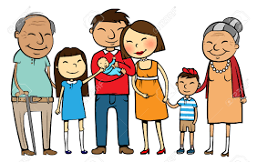
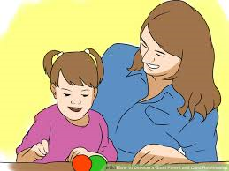
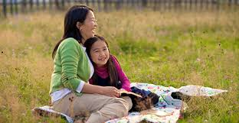
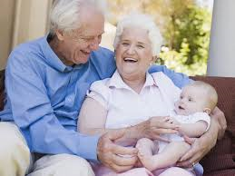
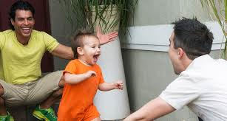
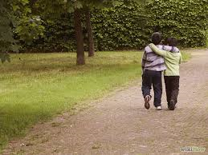
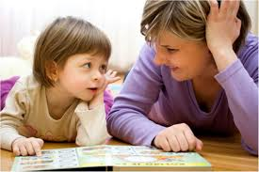
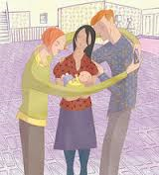

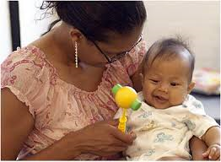
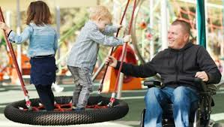
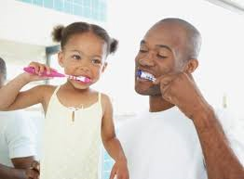
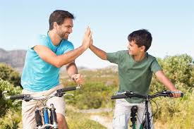
RELATIONSHIPS

Slide 6
WORKSHOP OUTLINE
The importance of relationships in nurturing resilience
To consider strategies that enhance resilience

Slide 7
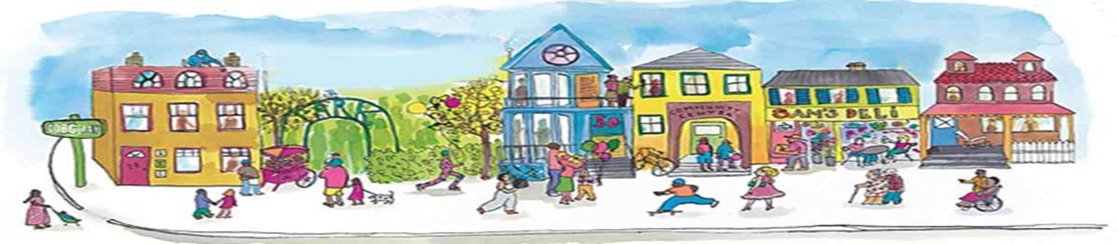
Recognising the importance of good relationships and defining new ways of developing and maintaining strong social connections are integral to our nation’s wellbeing.

Slide 8
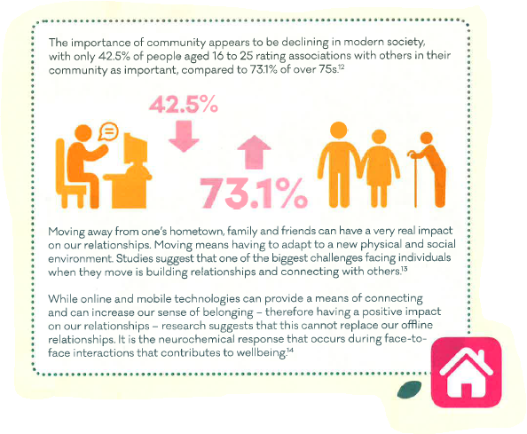
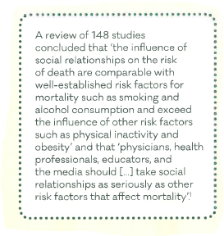
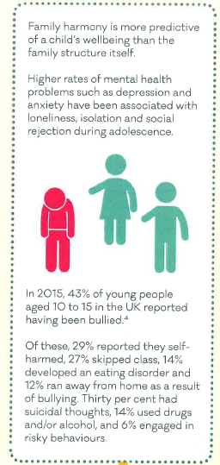
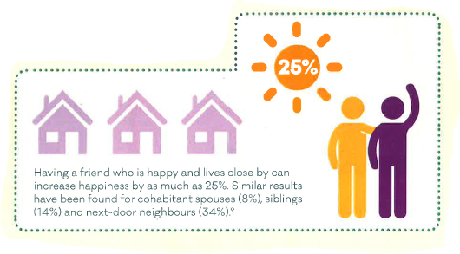

Why Relationships matter across the life course:

Slide 9
Learning how to engage with others
 | Emotional/ social development | Intellectual Development | Behavioural Development
Infancy | Trust/attachment | Alertness/curiosity | Impulse control
Toddlerhood | Empathy | Communication/ mastery motivation | Coping
Childhood | Social Relationships | Reasoning/ problem solving | Goal-directed behaviour
Adolescence | Supportive social network | Learning ability/achievement | Social Responsibility
AFFECT REGULATION
Ref: Jane Barlow (Professor of Public Health in the Early Years) Uni of Warwick

Slide 10
Poverty
Poor housing
Unemployment
Community problems…..
Neurological changes in the brain
Social adversity
Toxic stress
Poor quality carer-infant interaction
High cortisol/stress hormone levels
Biological embedding of social adversity
Ref: Jane Barlow, Professor of Public Health in the Early Years

Slide 11
Quality not quantity
Poor-quality relationships can be as toxic, and worse for our mental health, than being alone.
Mental Health Foundation, 2016

Slide 12
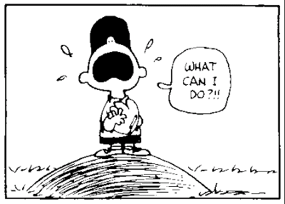
Help!

Slide 13
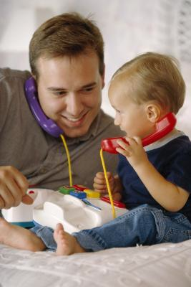




WHAT CAN IMPROVE THE QUALITY OF OUR RELATIONSHIPS?
Attuned
Communication

Slide 14
What is attuned communication?
What does it look like?
We know it when we see it….

Slide 15

Receiving initiatives
Being attentive
Developing attuned interactions
Guiding
Deepening discussion
Encouraging initiatives
The
Principles of Attuned Interaction

Slide 16
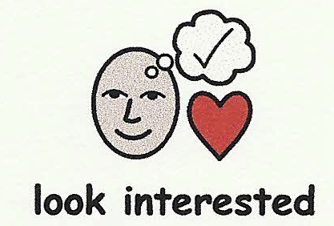
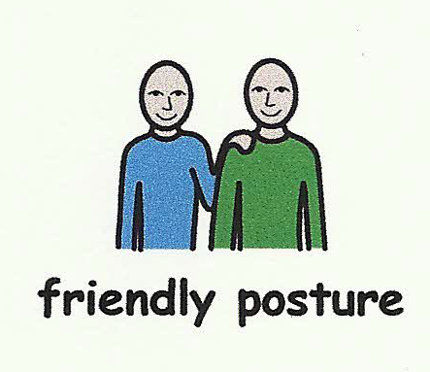
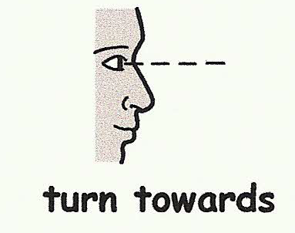

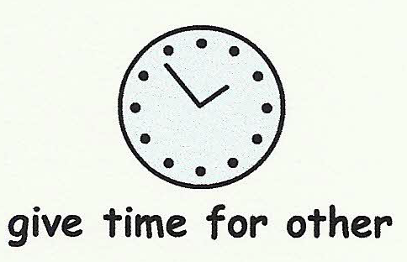
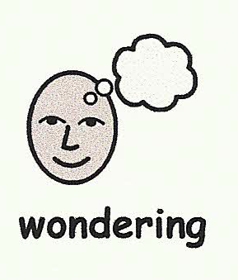
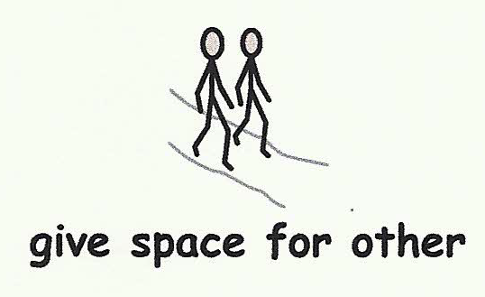
Being attentive

Slide 17
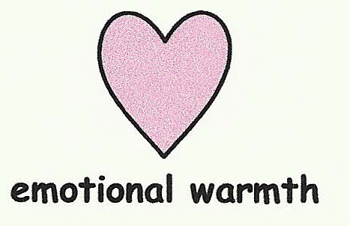
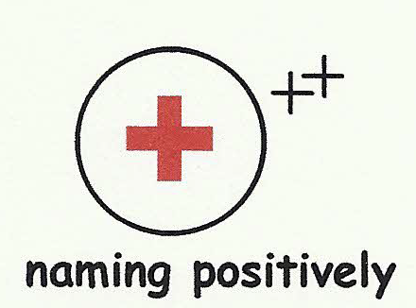

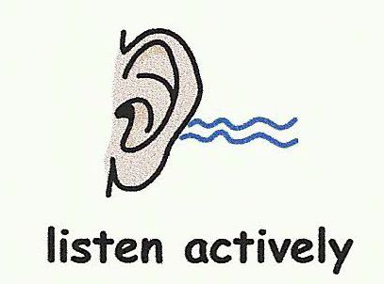
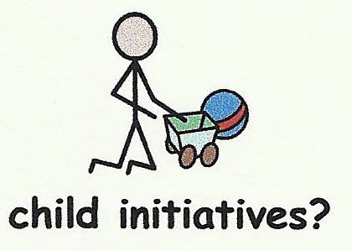
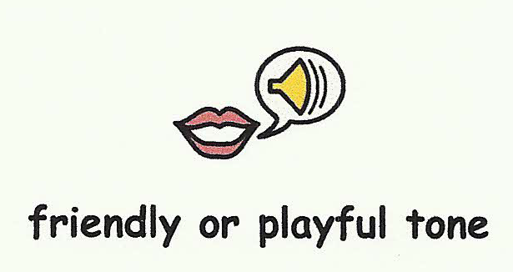

Being attentive
Encouraging initiatives

Slide 18
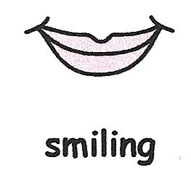
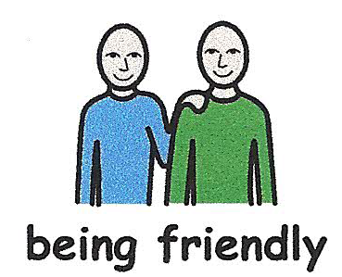
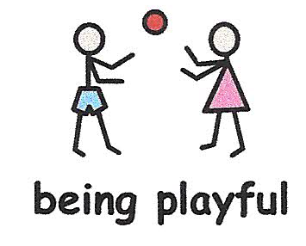
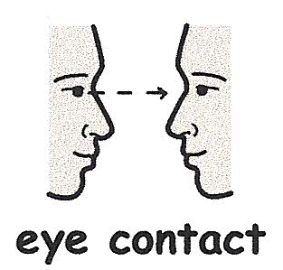
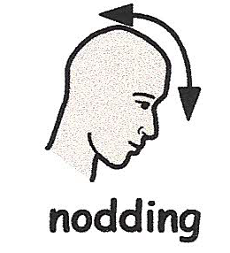

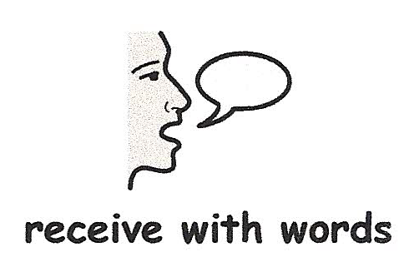
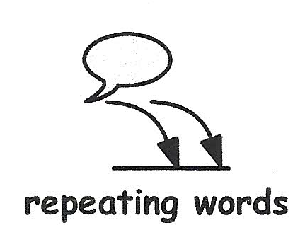
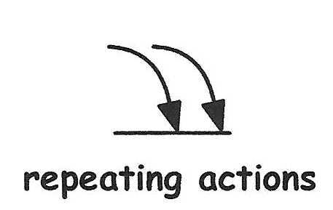
Receiving initiatives
Being attentive
Encouraging initiatives

Slide 19
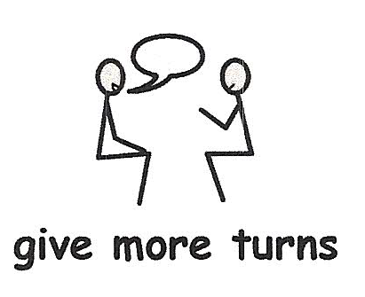
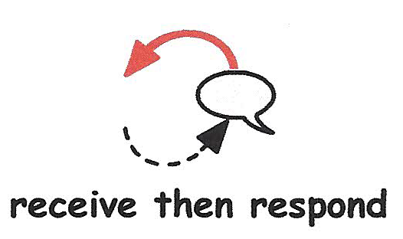
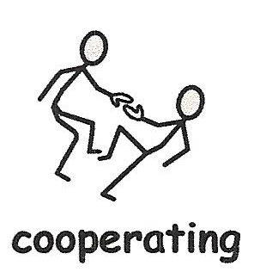
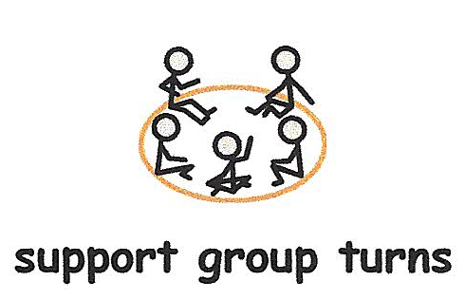
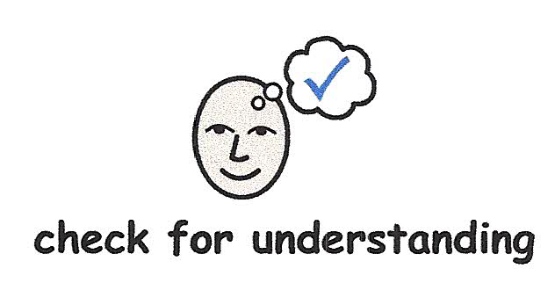
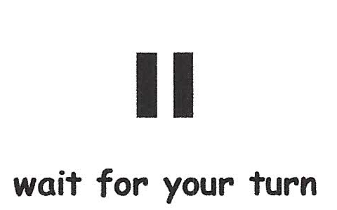
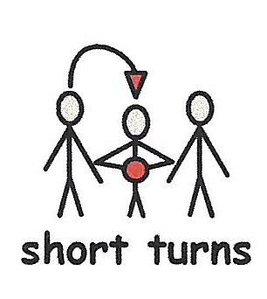
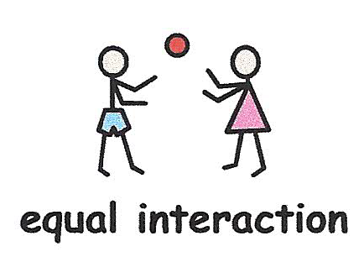
Receiving initiatives
Being attentive
Developing attuned interactions
Encouraging initiatives

Slide 20
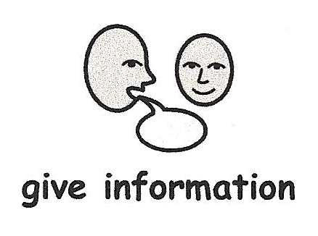
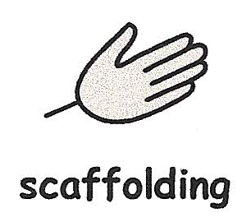
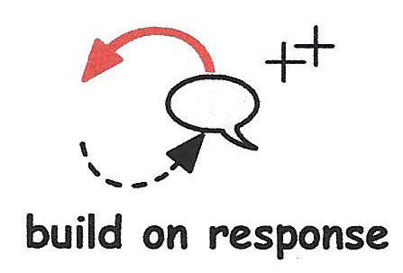
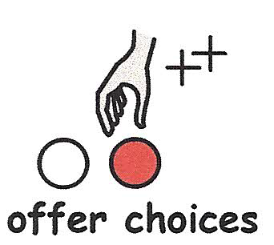



Receiving initiatives
Being attentive
Developing attuned interactions
Guiding
Encouraging initiatives

Slide 21









Receiving initiatives
Being attentive
Developing attuned interactions
Guiding
Deepening discussion
Encouraging initiatives

Slide 22


- Builds on strengths to enhance relationships
- Evidence-based, short-term intervention
- Combines the positive feedback from a visual image with an attuned relationship with the professional
- Practitioner uses video clips of authentic situations to enhance communication within ANY relationships e.g. mother/baby, teacher/pupil, older person/carer, manager/supervisee
What is Video Interaction GuidanceTM?
www.videointeractionguidance.net

Slide 23

VIG is recommended as an evidence-based intervention in….
NSPCC
NICE GUIDELINES
Social and Emotional Wellbeing 0-5 October 2012
Autism : the management and support of children and young people on the autism spectrum
August 2013
Children’s attachment
October 2013
PUBLIC HEALTH ENGLAND
Rapid Review of Healthy Child Programme (2015)

Slide 24
VIG VIDEO LINKS
What is VIG
Parents/carers talk
Cornwall.

Slide 25
RESILIENCE MATTERS
How we define resilience matters…

Slide 26



DEFINITIONS OF RESILIENCE MATTER
We wouldn’t want to be working with this definition…
The personal qualities that enables one to thrive in the face of adversity

Slide 27
What do academics think resilience is?
Positive adaptation despite adversity
Garmezy and Rutter, 1983
Notes:
1st Wave: Definitions centre on attributes specific to the individuals such as personal qualities, capacities, skills and abilities
2nd Wave: Protective and risk factors incorporating meso level. Definitions characterised by abstractions such as processes, patterns, vulnerability, risk and protection
3rd Wave: More systemic understanding of resilience. Definitions refer to dynamic processes, systems and negotiation
4th Wave: An ecological understanding of resilience places individual and adversity within micro, meso, macro and exo context

Slide 28






Critique of resilience…
For some people, building personal resilience is nothing more than:
“putting a sticking plaster over the wound caused by macro-structural inequalities in power and resources”
Taylor, Mathers, Atfield and Parry, 2011
Notes:
This is about responsibility
Where we see responsibility affects how we understand health and who is responsible for reducing inequalities
R is seen as dangerous as being part of processes which responsiblises individuals
This is when inequalities are understood as the result of individual differences not the result of structural processes
R is being presented by government policy as a way to reduce health inequalities and the links between structural causes and impact of inequality are concealed accountability can be denied
In other words responsibility for dealing with inequality is shifted from governments to individuals
When understandings of resilience are individualising

Slide 29

.We need to “redefine resilience as the ability to not only cope with conditions related to adversity and injustice but also to challenge their very existence”
Prilleltensky and Prilleltensky, 2005
Notes:
We are saying that Resilience needs to do more than just help support people to cope with adversity, we agree with the Prilleltenskys that resilience needs to challenge the very structures that create disadvantage, discrimination and oppression.

Slide 30





Hart et al’s definition of resilience
“Overcoming adversity, whilst potentially subtly changing, or even dramatically transforming, (aspects of) that adversity”
“Beating the odds whilst changing the odds”
Hart, Gagnon, Aumann, & Heaver, 2013

Slide 31
Help!

Slide 32
Boing Boing Resilience Frameworks
Child and Young People
https://www.boingboing.org.uk/wp-content/uploads/2017/04/Interactive_Resilience_Framework.pdf
Family
https://www.boingboing.org.uk/wp-content/uploads/2016/10/Resilience-Framework-family-resilience-2016.pdf

Slide 33
The relationships we form as children and young people are predictors of our future mental health and wellbeing
The quality of our relationships is as critical as not smoking, and is more important than eating well or exercising.
NEED A SEA CHANGE IN THINKING
Notes:
We need to ACTIVELY BUILDING AND MAINTAING GOOD RELATIONSHIPS

Slide 34
RELATIONSHIPS RESOLUTION
Be present
Listen
Give time
Recognise unhealthy relationships
Be listened to

Slide 35
People, not programs, change people
Bruce Perry

Slide 36



Thank you for being attentive!
oonagh.davies@gloucestershire.gov.uk
tamara.brito2@gloucestershire.gov.uk
Video Links: What is VIG Parents/carers talk Cornwall.

