Slide 1
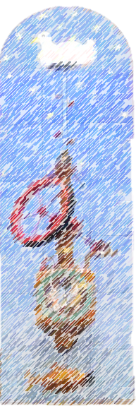

Cheltenham Children’s Needs Assessment 2018
Notes:
Good afternoon, I am here to present some of the key finding of the 2018 Cheltenham Children and Young People Needs Assessment which the data and analysis team at the county council produced on the request on Cheltenham Borough Council

Slide 2








Overview
In general children in Cheltenham have access to good education and have good academic attainment. They are less obese than the national average and report exercising more than children in the other districts.
However not all children thrive in Cheltenham; this Needs Assessment looks at many aspects of growing up in Cheltenham to identify how we can enable all children to flourish and achieve.
Notes:
The needs assessment found that Generally employment levels are good, access to services and cultural assets are also generally good. Life expectancy generally in Cheltenham is inline or better than the England average.
However not all children thrive in Cheltenham; the Needs Assessment looks at many aspects of growing up in Cheltenham to identify how we can enable all children to flourish and achieve.
The full needs assessment covers all of the topics you can see at the bottom of the slide, however today we are going to be looking at just a few of these as well as the demographics of Cheltenham to give some context

Slide 3



Demographics and Deprivation
34,558 children and young people age 0-24 living in Cheltenham
23,282 under 18
Cheltenham
Children & Young people (0-18yrs) living in Quintile 1 (most deprived )
Gloucestershire
13.21%
8.96%
Notes:
In 2016 an estimated 34,558 children and young people aged 0-24 were living in Cheltenham, of these 23,282 were under 18. The proportion of Cheltenham residents that are children and young people (211% county average 21.4%).is similar to the county proportion.
Growing up in areas affected by deprivation is shown to damage children’s health, wellbeing and future life chances. The Index of Multiple Deprivation (IMD) is a nationally acknowledged measure that combines a number of indicators chosen to cover a range of economic, social and housing issues, into a single deprivation score for small areas, known as Lower Super Output Area (LSOA).
In Cheltenham 13.2% of children and young people live in the most deprived areas this was higher than Gloucestershire as a whole with 8.96% of children living in the most deprived areas. However around 2/5 (44%) of children under 18 in Cheltenham live in Q5 the least deprived quintile which is higher than the Gloucestershire level (31%), this shows there is a great deal of polarity across the district.

Slide 4
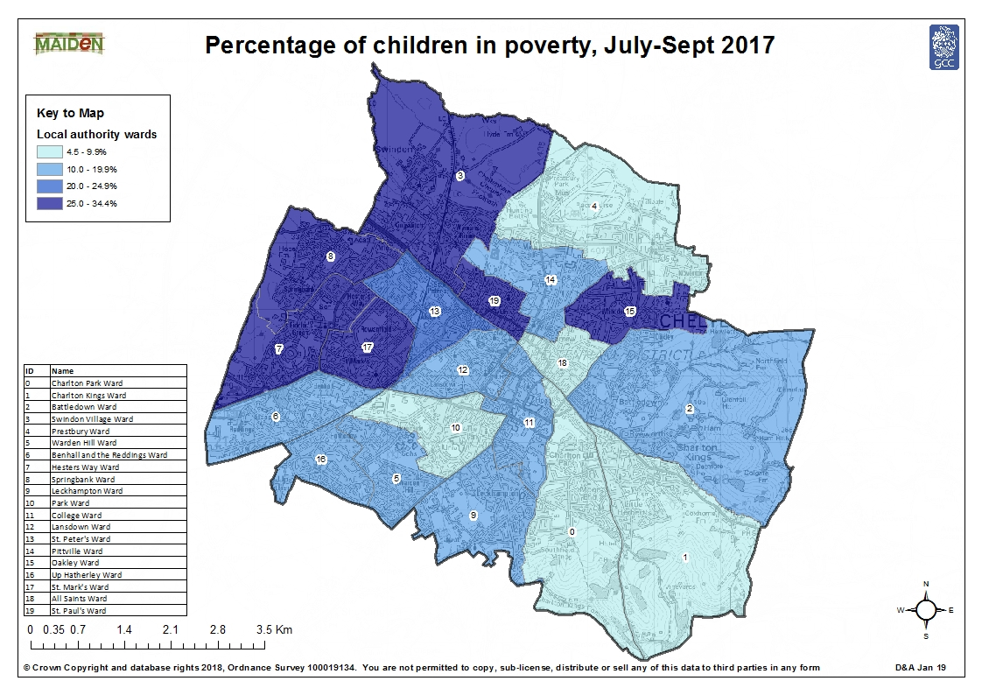
1 in 5 children live in poverty
Notes:
The Indices of deprivation takes into account a variety of factors from living environment, educational outcomes and income,
The income or poverty element of deprivation is said by many to have a particular impact creating long term disadvantages for children and leading to consequences including emotional issues, delayed development and lower academic achievement among others which put a child behind peers who do not struggle with poverty.
Households are classed as living in poverty if their household income (adjusted to account for household size,) is less than 60% of the average.
Overall there are around 4,310 children in Cheltenham who are classed as living in poverty once housing costs are taken into consideration, which equates to around 1 in 5 children (19.5%), while this is lower than the national average of 26.8% it is undoubtedly significant. There are significant differences across the district as shown by this map, while all wards have at least 4% of children living in poverty, 35% of wards have more than a quarter of children living in poverty (shaded dark blue) and in St Pauls and Oakley wards over a third of children were living in poverty.
Working poverty is an issue in Cheltenham in particular in Lansdown and College areas. Where a higher proportion of households with children are in poverty than households with children claiming out of work benefits, one factor that may contribute to this is the high housing costs in the district

Slide 5

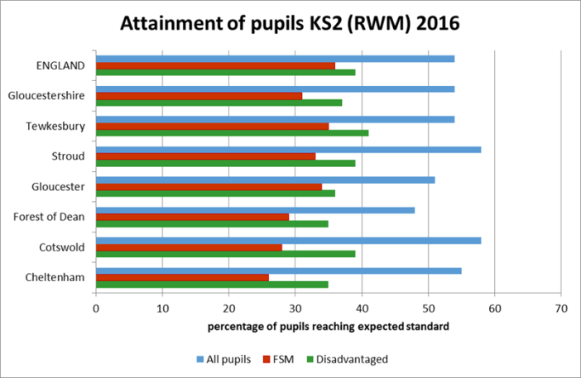

The proportion of children reaching a good level of development at EYFS was above the Gloucestershire average. But this varied widely across smaller areas of Cheltenham.
The proportion of children reaching the expected standard at KS2 is higher in Cheltenham overall but disadvantaged pupils do much worse
Notes:
We are now going to look at the relationship between poverty and educational attainment.
Influences on educational attainment and successful future outcomes can start early in a child’s life. Access to good quality Early Years education has been shown to help children be more school ready and reach a higher level of development at the end of EYFS.
Overall in Cheltenham Attainment at the end of the early years foundation stage was higher than the England average, However there is a considerable variation with 79.1% of children in Charlton Kings CC reach area reaching a good level of development compared to 58% in Rowanfield. Even at this young age there is also a significant difference between all children and children eligible for free school meals which is used as a proxy for poverty, with 70% of all children reaching a good level of development compared to 47% of children eligible for free school meals
The graph shows the proportion of pupils achieving the expected standard in RWM at KS2, with the blue bars representing all pupils, the green disadvantaged pupils and the red pupils eligible for free school meals. As you can see overall the proportion of all pupils achieving the expected standard was in line with the regional and national average (55 vs 54). However when you look at the results of disadvantaged pupils (pupils in care and FSM) or pupils eligible for FSM , there is a large gap with 35% of disadvantaged pupils making the expected progress and 26% of FSM pupils, this compares to 55% of all pupils . In fact the percentage of FSM pupils achieving the expected standard at KS2 in Cheltenham was the lowest in the county and was also significantly lower than the overall Gloucestershire level and national level (31 and 36)

Slide 6

Attainment at KS4 is higher than the county and national averages in Cheltenham overall but disadvantaged pupils do significantly worse
Notes:
As with EYFS Key Stage 2, attainment for all pupilsat Keys Stage 4 as measured by the attainment 8 score (measures the achievement of a pupil across 8 qualifications including maths (double weighted) and English (double weighted), 3 further qualifications that count in the English Baccaluaretee measure and 3 further qualifications that can be GCSE qualifications or any other non GCSE qualifications. Each individual grade a pupil achieve is assigned a point score, which is then used to calculate a pupils attainment 8 scores was above the county and regional average. However attainment for vulnerable children was not as favourable. The average attainment 8 score for all pupils was 54, this compares to 38 for disadvantaged pupils and 34 for pupils eligible for FSM.
In Cheltenham FSM and Disadvantaged pupils had an average attainment 8 score that was significantly lower than the Gloucestershire and England average for similar children
Progress 8 aims to capture the progress a pupil makes from the end of primary school to the end of secondary school. It is a type of value added measure , which means that pupils results are compared to the actual achievements of other pupils with similar prior attainment. In Cheltenham pupils make slightly more progress than nationally, however FSM pupils and disadvantaged pupils make less progress (equivalent to more than half a grade less)

Slide 7

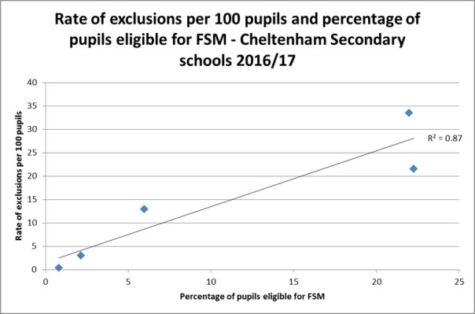
The rate of fixed term and permanent exclusions in Cheltenham is higher than the Gloucestershire average.
There is correlation between FSM eligibility and Exclusion rates
Notes:
Exclusion from school potentially sets a child on a path to poorer qualifications, poorer job prospects and smaller life time earnings. There are two types of exclusion from school: Permanent exclusion (or ‘expulsion’)is removal from a school roll • Fixed-term exclusion (or ‘suspension’) is exclusion for a set number of days, not totalling more than 45 days in a school year.
Gloucestershire has a higher rate of fixed term and permanent exclusions than nationally and has seen sharp increases in permanent exclusions in recent years. In Cheltenham the rate of permanent and fixed term exclusions exceeds the county and national average and has also been increasing in recent years, this is particularly noticeable at secondary schools, with all secondary phase schools in Cheltenham seeing an increase in the percentage of pupils with at least one exclusion
The rate of exclusions vary considerably across schools, however schools with a higher percentage of pupils eligible for FSM also have the a higher rate of exclusions suggesting poverty has a link to parenting and behaviour of children, this correlation is seen at primary school and secondary school but by secondary school it gets much stronger, suggesting that as children get older the impact of living in poverty is more pronounced (R score +0.7 or greater suggesting strong psitive corelation, 1= perfect).

Slide 8

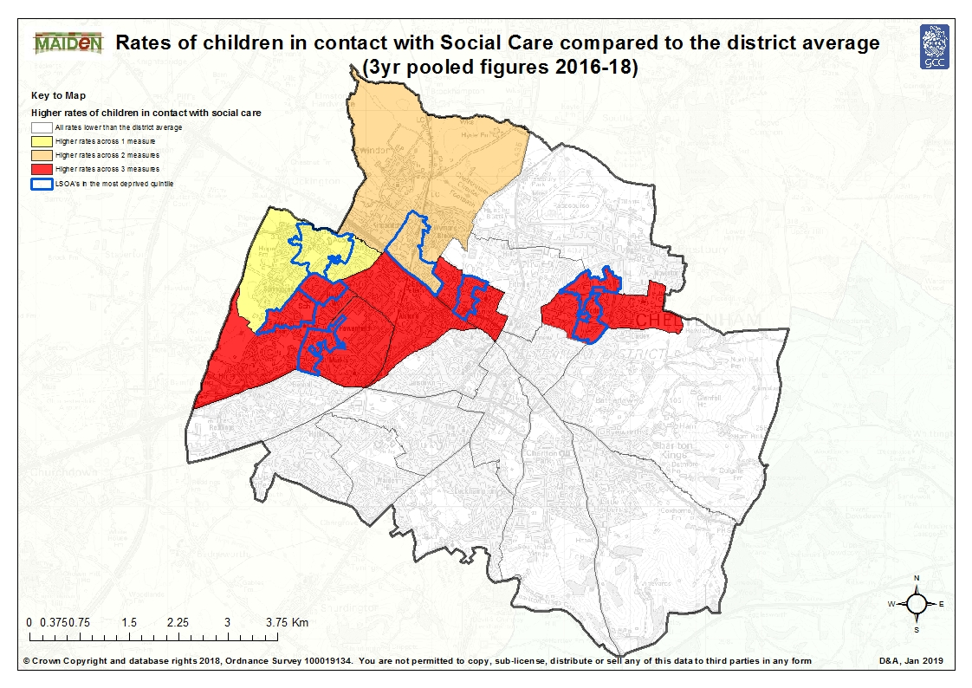
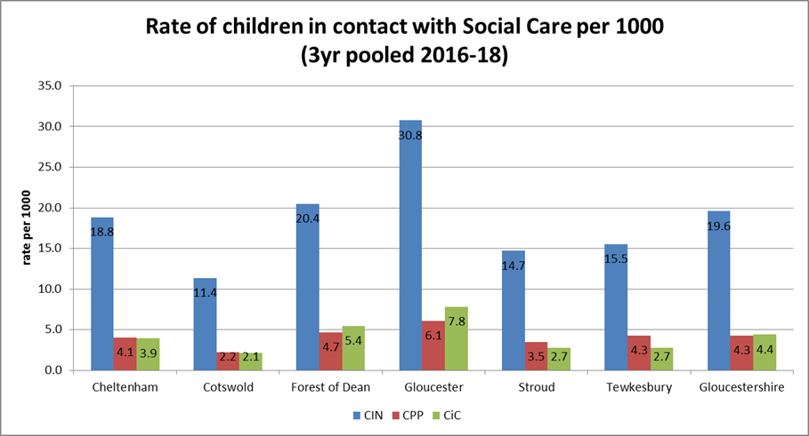
Cheltenham is inline with Gloucestershire in terms of children known to Social Care although 5 wards are much higher
Notes:
We are now going to move on to look at stable and supportive family life
Cheltenham appears to be in-line with the Gloucestershire rates for Children in Need, children on a Child Protection Plan and Children in Care, as you can see from the graph. However there is significant variation across the district with rates significantly higher across all 3 measures in Hester’s Way, Oakley, St. Paul’s, St. Peter’s and St. Marks shown on red on the map) .
Recent research suggests there is a strong correlation between deprivation and child welfare interventions . All the wards identified (except St. Peter’s) had areas within them that fell into the most deprived 20% nationally as shown by the blue boundaries.
Swindon Village (shaded orange) which exceeded the district average for two measures (CIN and Cic) also had an area in the top 20% most deprived, as did Springbank which exceeded the district average in terms of CIN, suggesting this correlation is evident in Cheltenham

Slide 9

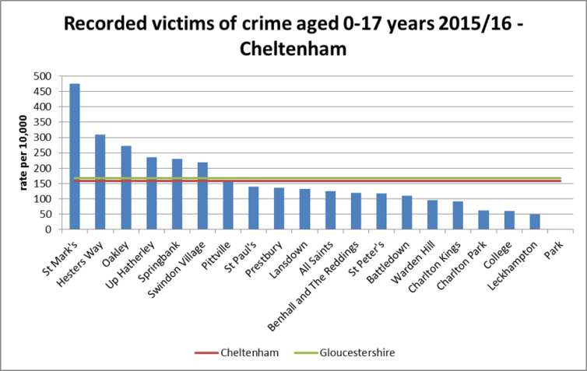


The proportion of children saying they felt unsafe at home was relatively high in Cheltenham (2.9%)
The rate of children who were victims of crime in Cheltenham was inline with Gloucestershire (161 per 10,000) but was significantly higher in two wards
Youth offending rate for Cheltenham in 2015/16 (59.6) was slightly above the Gloucestershire rate (57.1)
Notes:
This section looks at feeling safe and secure. Cheltenham secondary schools had the second highest proportion of pupils who reported feeling unsafe or very unsafe at home or the place where they live (2.9%). Gloucs. 2.6% Tewkes 3.4%
The rate of children and young people who were victims of crime was also higher in Cheltenham than all the other districts except Gloucester. At ward level there are clear differences. The chart illustrates the rates of victims were particularly high in St. Marks, Hester’s Way (significantly higher) and Oakley
National evidence suggests young people are responsible for 17% of all proven offences and on average young offenders are more likely to re-offend than adults. Youth offenders are more likely to have learning difficulties or mental health issues than the general population and their life chances will be adversely affected by offending. The youth offending rate for Cheltenham in 2015/16 (59.6) was slightly above the Gloucestershire rate (57.1), this shows there are areas to work on.

Slide 10

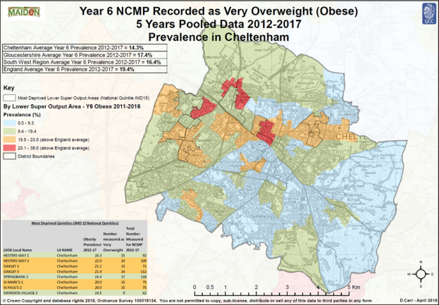
In general obesity levels in Cheltenham are low however more deprived areas have much higher levels
Notes:
The next sections looks at some of the key points relating to physical health and mental health, starting with obesity. Its well know that obesity can lead to a number of serious and potentially life threatening conditions such as type 2 diabetes, coronary heart disease, some types of cancer and stoke. It can also affect quality of life and lead to psychological problems such as depression and low self esteem.
In general prevalence of obesity in Y6 children in Cheltenham is lower than the county and national averages at 14.3% of pupils being obese.
However there are areas that have significant higher proportion of year 6 pupils who are obese. The orange and red areas on the map are those that exceed the national average for the proportion of pupils who are obese, 5 of the 8 most deprived LSOAs had obesity prevalence above the England average. However the areas with the highest prevalence of obesity in year 6 children (shaded in red) fell into quintile 2.
The Online Pupil Survey collects information about healthy behaviours it showed that Children in Cheltenham secondary schools reported the highest proportion undertaking 6 or more hours of exercise per week in the county and conversely the lowest proportion of children stating they did only 1-2 hours per week. However, 28.1% of secondary phase pupils in Cheltenham reported they would like more support or knowledge around getting fit, this was higher than most other districts
A high proportion of secondary phase pupils in Cheltenham (23%) reported never eating unhealthy snacks or only eating unhealthy snacks once a week when compared to the other districts and the overall Gloucestershire percentage. In contrast just over a third reported they ate unhealthy snacks 3-5 times a day which was lower than all districts except Cotswold and Stroud.
7.1% of children in Cheltenham reported drinking regularly inline with Gloucestershire average and lower than all districts except Gloucester. However Cheltenham rate of admission for alcohol in children under 18 is higher than the Gloucestershire rate of 52.7 at 59.6, as shown in the graph

Slide 11
Questions
For more information contact : informgloucestershire@gloucestershire.gov.uk

