Slide 1
ACEs:
From theory to practice
Sarah Scott
Director in Public Health
Gloucestershire County Council

Slide 2
Overview
What are ACEs?
The impact of ACEs on:
Children
Young people
Adults
Resilience trumps ACEs
Action on ACEs Gloucestershire

Slide 3
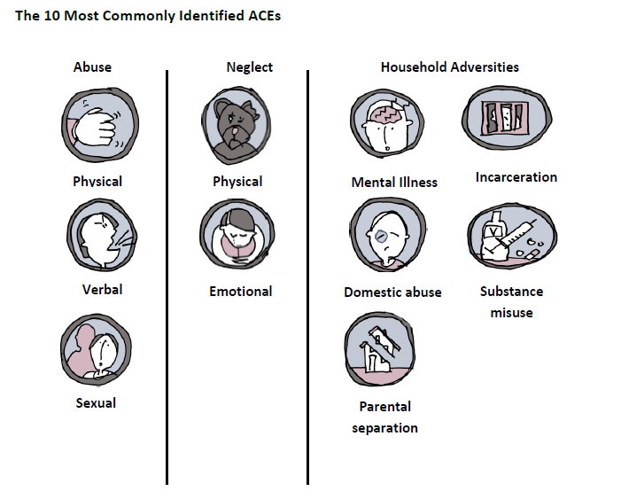
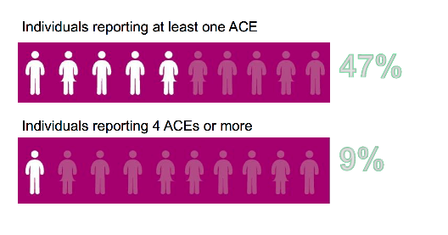
Adverse Childhood Experiences (ACEs)

Slide 4
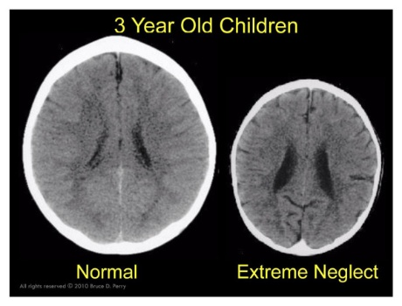
The impact of ACEs on children
Exposure to intense, frequent, or sustained stress without the buffering care of a supportive adult (i.e. toxic stress) can change children’s brains and bodies, including disrupting learning, behaviour, hormonal systems, immune systems, and even the way DNA is read and transcribed.
Source: Dr Bruce Perry

Slide 5
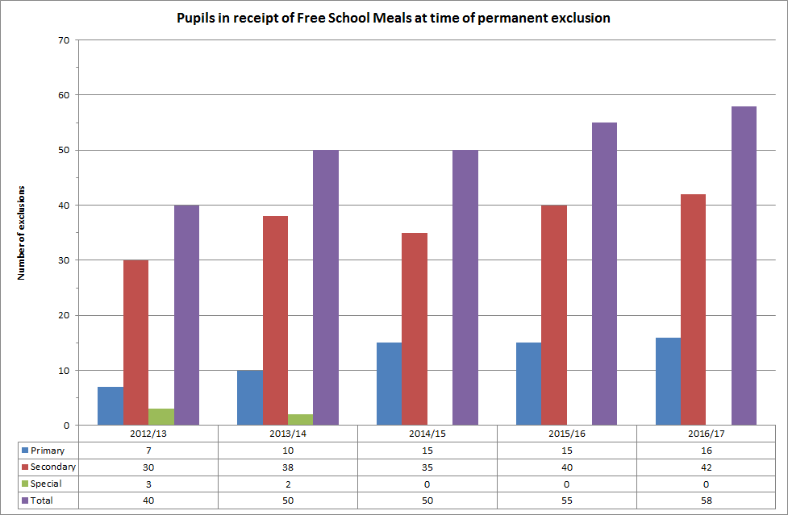
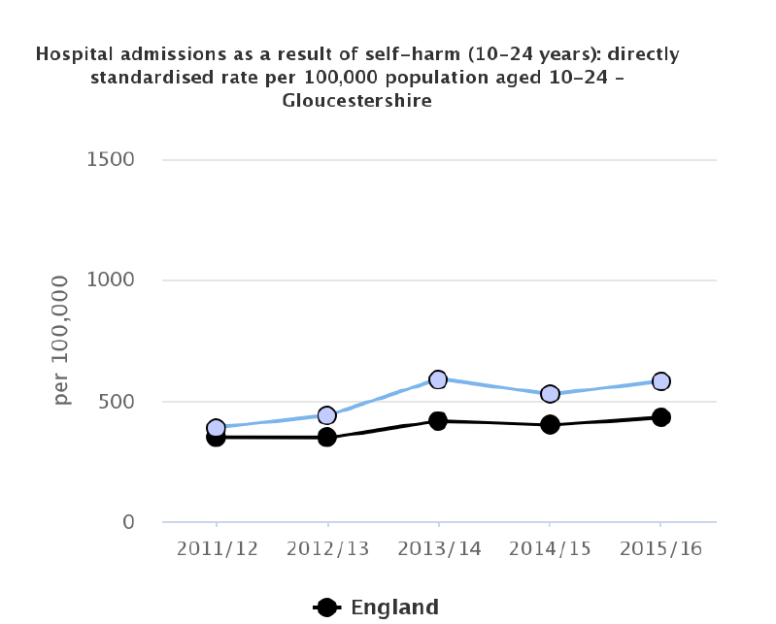
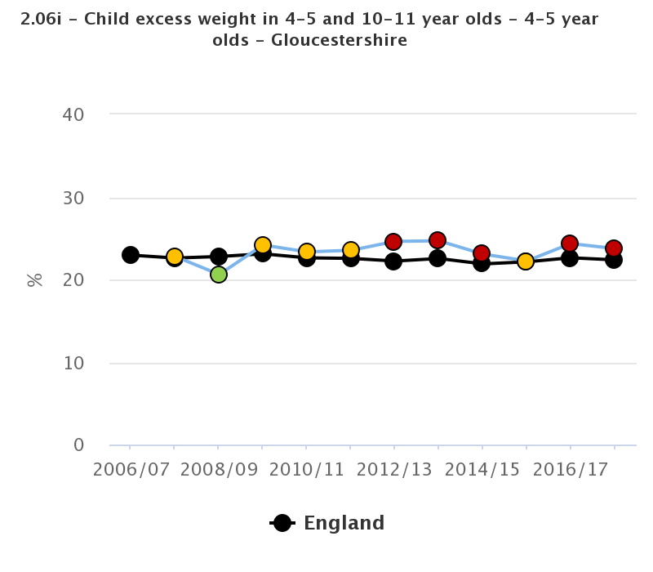
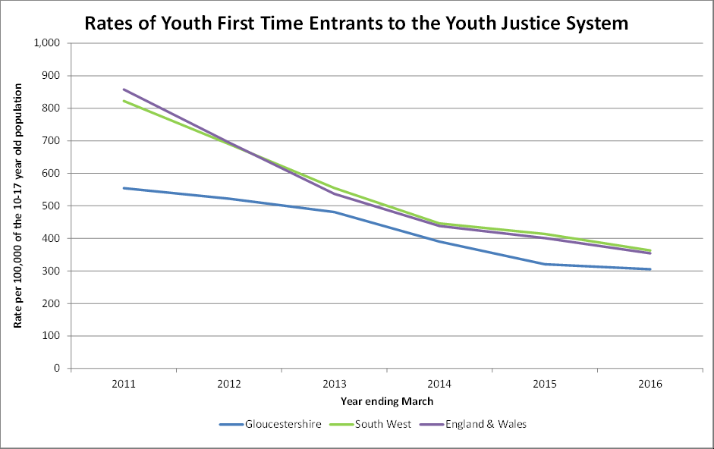
The impact of ACEs on young people
Frequent exposure to trauma and ACEs can result in an increase in lifestyle and risk - taking behaviours and negative socioeconomic outcomes.
In 2015/16, Gloucestershire was the highest permanent excluding Local Authority in comparison with its statistical neighbours to the national average. In 2015/16, Gloucestershire permanently excluded 0.16% of its school population compared to the national average of 0.08%.
The number of young people aged 10-17 entering the youth justice system as first time entrants has been declining nationally since 2007 when it was over 110,000 to under 20,000 in 2015/16.
Gloucestershire higher rate of self harm by young people aged 10-24 years 580.8 per 100,000 admissions than England average 430.5 per 100,000 (2017)
23.8% of Gloucestershire reception children are overweight than England average 22.4% (2017/2018)

Slide 6
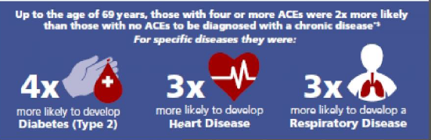
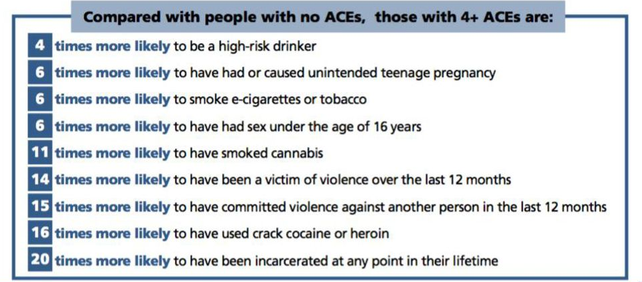
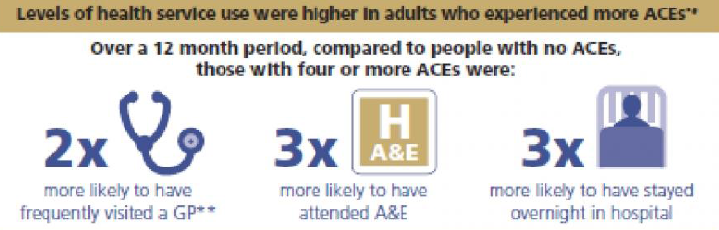
The impact of ACEs on adults
Experiencing adversity in childhood can have a significant impact on an individual’s future as an adult.
This can eventually lead to a greater demand and challenge on the system - health and social care, criminal justice.

Slide 7
Resilience
Developing resilience has been shown to improve outcomes even in those who experience high levels of ACEs.
Resilience is a complex concept.
In the ACEs strategy, resilience is defined as the ability to adapt well in the face of adversity.
The single most common factor for children who develop resilience is at least one stable and committed relationship with a supportive parent, caregiver, or other adults.

Slide 8
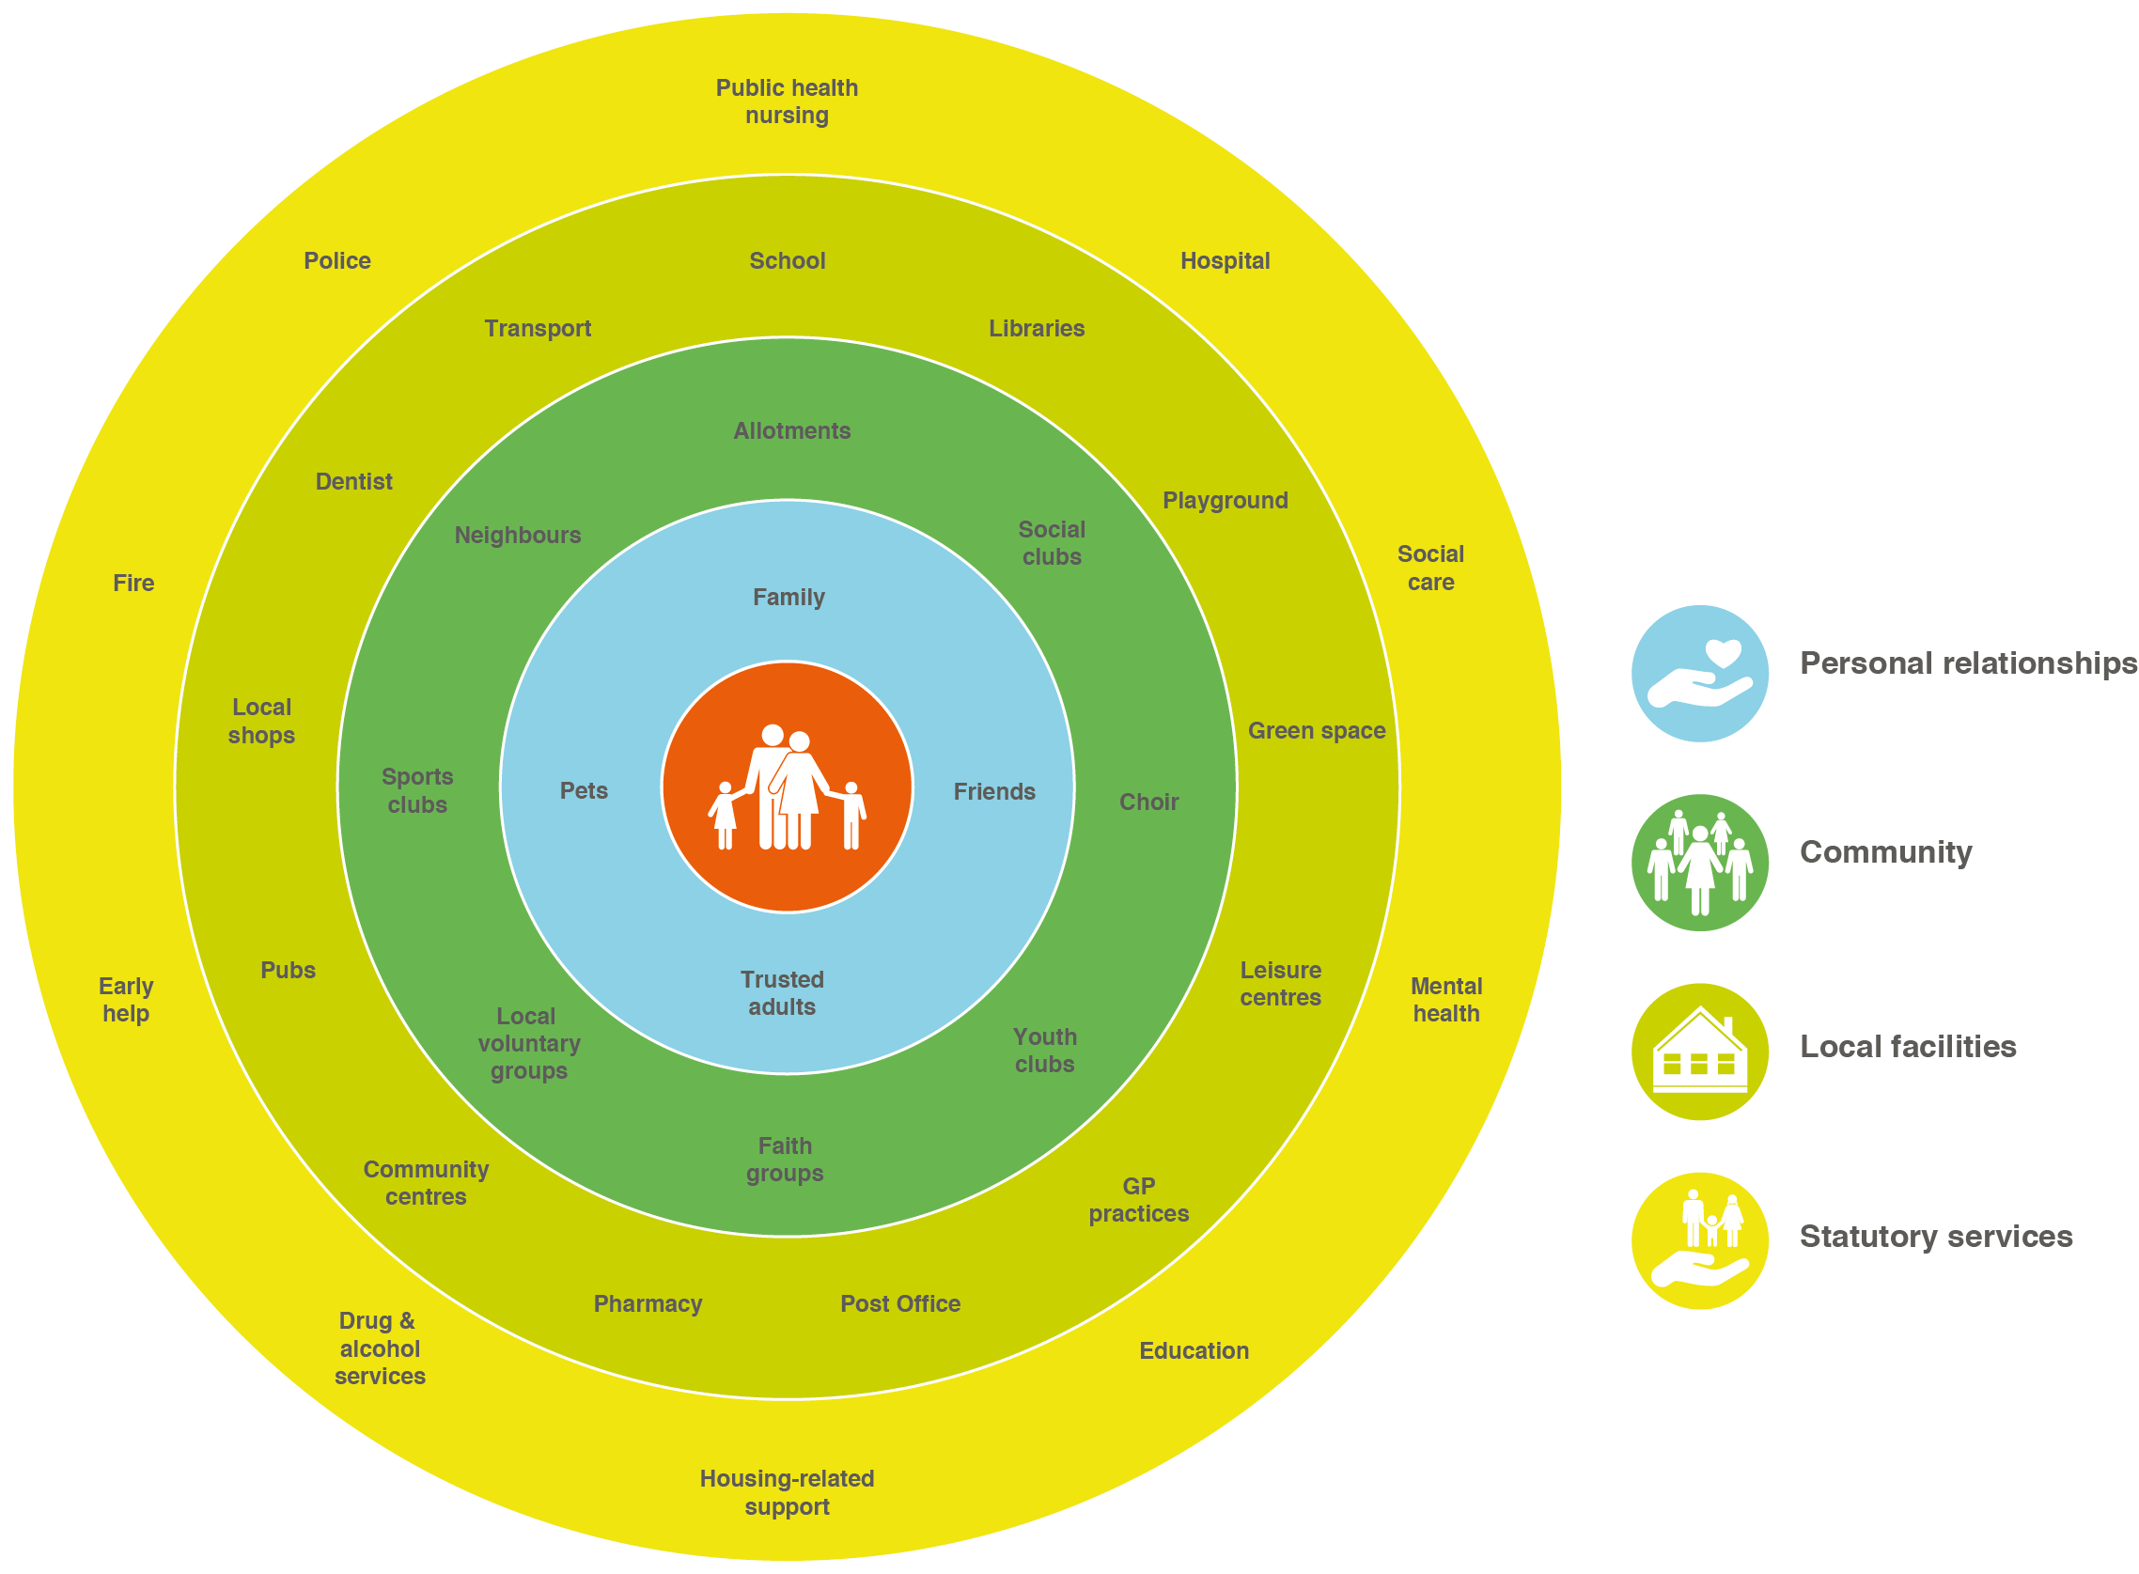

Slide 9
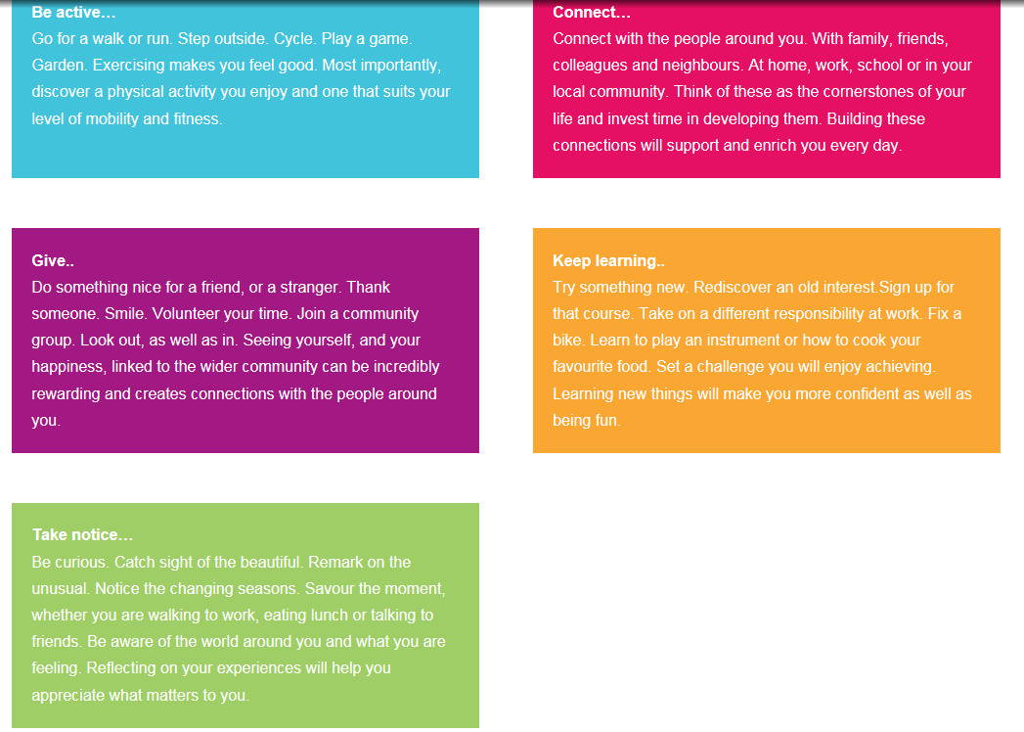
Five ways to wellbeing

Slide 10
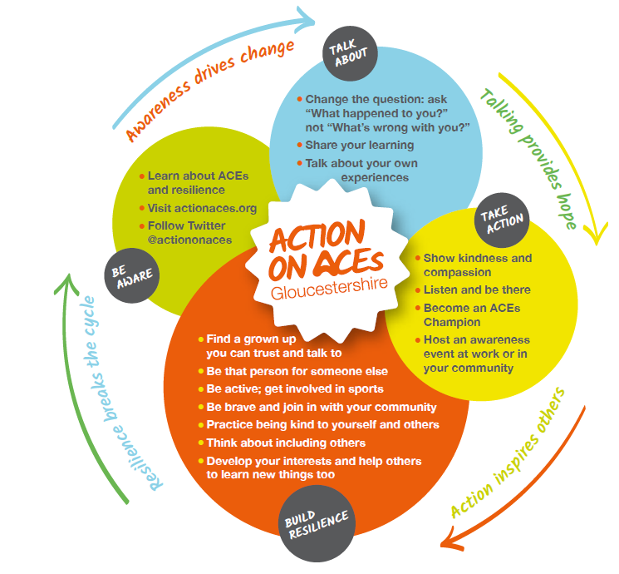
Action on ACEs Gloucestershire
Action on ACES Gloucestershire brings together representatives from local voluntary sector organisations and statutory agencies to raise awareness of ACEs.
Vision
A resilient Gloucestershire where communities and organisations are acting on ACEs.
Mission
To build our communities and organisations that are unaware of ACEs, talk about ACEs and take action on ACEs. We will build a social movement that recognisees the potential lifelong impacts of adversity in childhood and take action to stop childhood harm.

Slide 11
Viral Change to catalyse a social movement

Slide 12
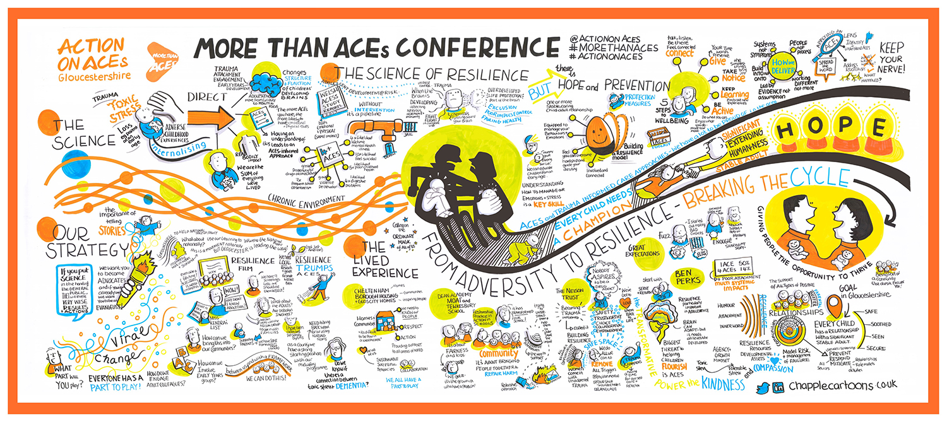
More than ACES Conference November 2018
More than ACEs was the first major conference held by Action on ACEs to launch its strategy. Almost 250 professionals and community organisations attended to hear from local, national and international speakers on 8th November in Cheltenham.

Slide 13







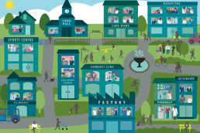
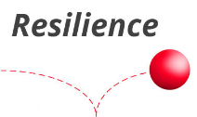
What are we doing in Gloucestershire
Toolkits
We have developed 3 toolkits (a universal tool, a community tool and a professional tool) to help embed ACEs into practice.
Champions Network
We are developing a network of ACEs Champions. The champion community will drive forward the Action on ACES messages.
Information and Resources
More resources are being added to the Action on ACEs website and twitter all the time .
Training
We are developing a skills and knowledge framework, implementation guidance and training packages for communities and organisations in Gloucestershire.
Distribution of ACEs
We are increasing our understanding of the distribution of ACEs in Gloucestershire and using this to build resilience and improve outcomes.
Campaign
We will continue our campaign during 2019 to raise awareness of ACEs and provide information and support to Champions, professionals and the public to act on ACEs and build resilience.
Evaluation
We are exploring partnerships with Public Health Wales and local universities to evaluate the use of viral change in implementing the ACEs strategy. We want to share our learning across the South West and beyond.
Building Resilient Gloucestershire
We are working to build resilience across all ages within communities and organisations in Gloucestershire.
Communities
Pilot work is starting to build ACE aware communities in Gloucestershire.

Slide 14
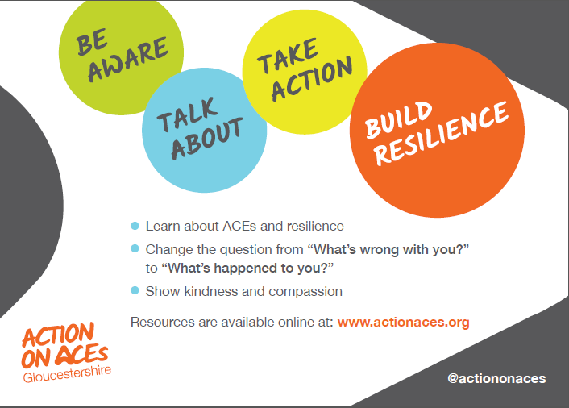
Going forward – what can you do?

Slide 15
Closing Remarks
‘’If you can put the science into the hands of the general public, they will invent very wise actions.’’
Laura Porter, co-founder of ACE interface

