Slide 1
















NCLB Community Agreement
www.nclbcheltenham.org.uk @NCLBchelt

Slide 2

What is NCLB?
Who we are…
No Child Left behind is a partnership of many organisations across all sectors who believe that ALL children in Cheltenham should have opportunities to thrive. Our partnership is made up of public services, such as the council, police and fire service, as well as schools, charities, housing providers and private sector organisations.
What we do…
We work together to improve the lives of Cheltenham families by organising free activities for residents to enjoy, training staff to recognise and understand the long-term impacts of challenges such as poverty and trauma and raising awareness of issues that disproportionately affect young people living in poverty, such as criminal exploitation, period poverty and poor mental health.
Why we do it…
Our assessment of children’s needs back in 2018 showed that in our town around 4400 children lived in poverty, and that they were statistically more likely to underachieve at school, be excluded, be a victim of crime, be known to social care, and have poor mental and physical health. We want to change this and ensure that they have what they need to overcome these barriers.

Slide 3
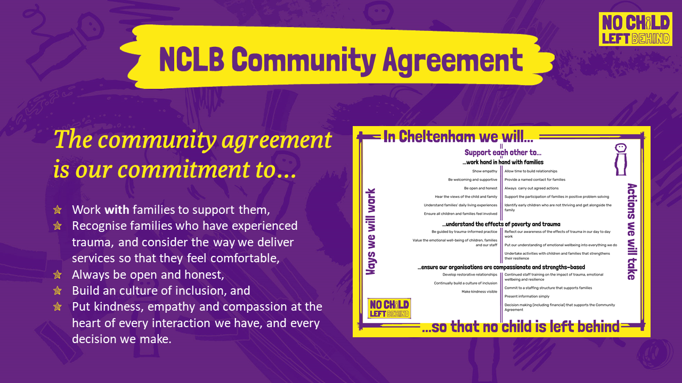

Slide 4


